Slide 1



Optimus Pro

Slide 2


Vision Mission
Vision Statement
Empowering global workforce to accomplish more.
Mission Statement
Connect the world’s professionals to make them more productive and successful by enhancing communication and personalizing information

Slide 3



Product Positioning Statement
LinkedIn Communication is an enhanced version of LinkedIn that enables students, corporates and recruiters to collaborate more effectively with better ease. By empowering communication, we take care of User's professional networking needs that helps them grow their business, brand and opportunities like never before.
Exit

Slide 4

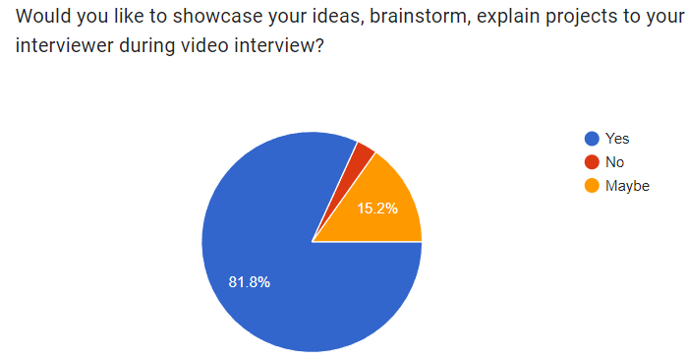
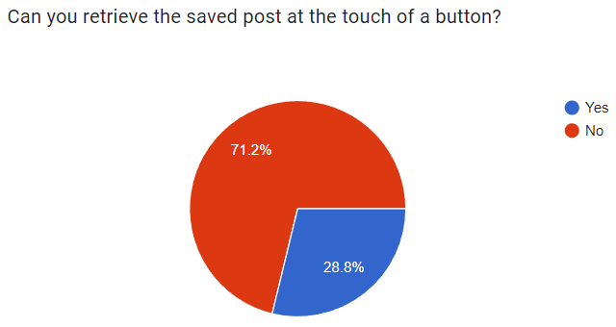
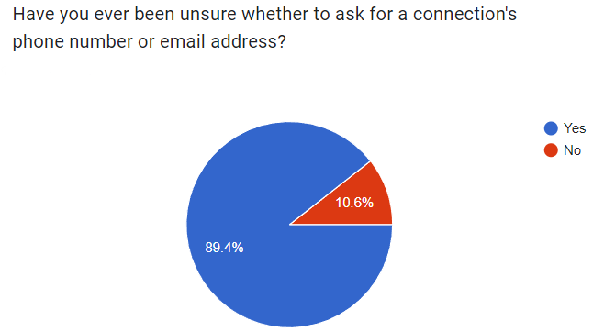
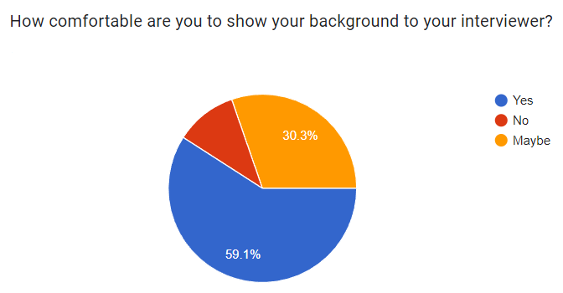
Problem Statements

Slide 5

Features
01
Categorize Saved Posts into different buckets.
02
Enhancing Video call experience by adding Whiteboards and Background Blur Effects to LinkedIn Meetings.
03
Preferred Way of Communication feature in the Messages Slack/Meets

Slide 6
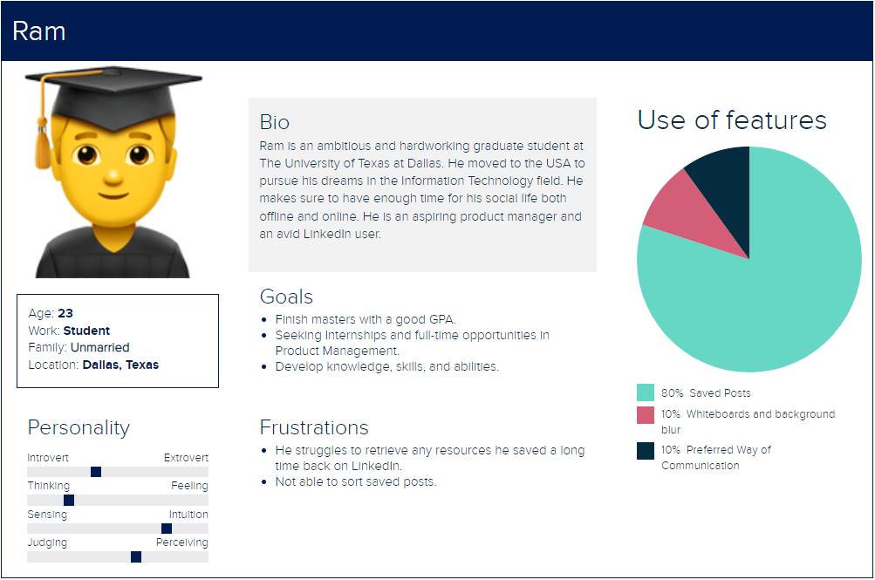
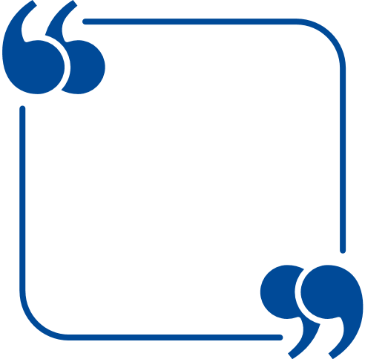
User Persona
Very difficult to find saved posts -
I almost always have to google how to find them.

Slide 7
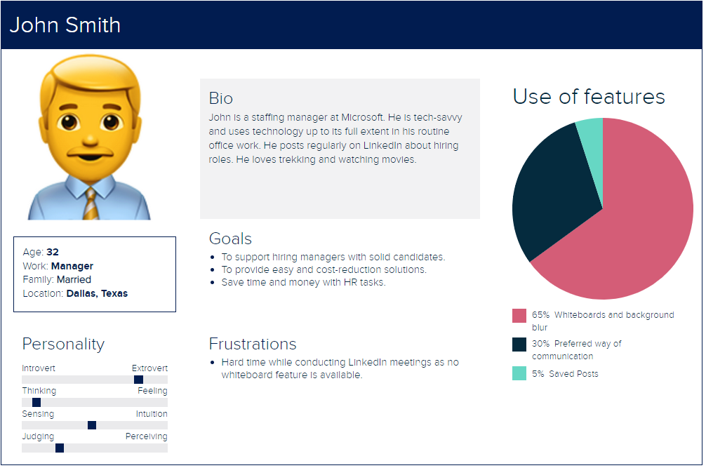
User Persona
Downloading the notes explained by an interviewee during the interview helps me differentiate the candidates.

Slide 8
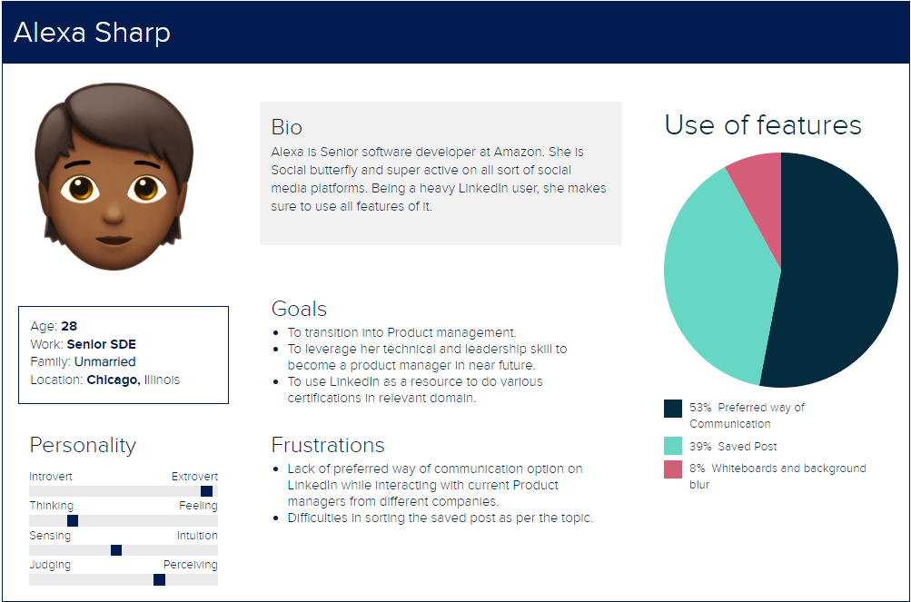

User Persona
I'm clueless most of the times, whether to ask phone number or email address.

Slide 9
Customer Journey Mapping : Saved Posts
easy to share
Organised content
Resource
Able to locate saved posts with ease
Enriched Experience
Fast
Emoji
Professional Updates
Visible Save Icon
Gained valuable experience
relevant
Close
Baseline
Spam
Frequent Occurance on feed
wasted time/ distracted by irrelevant information
Slow
irrelevant
Unable to find icon
Cluttered information
Poor Experience
No Time
Unable to locate saved posts
Enter
Engage
Exit
Reflect
Open LinkedIn
Check Feed
Like a Post
Share post
Refer later
Save Posts
Retrieve
Find
Close Website

Slide 10
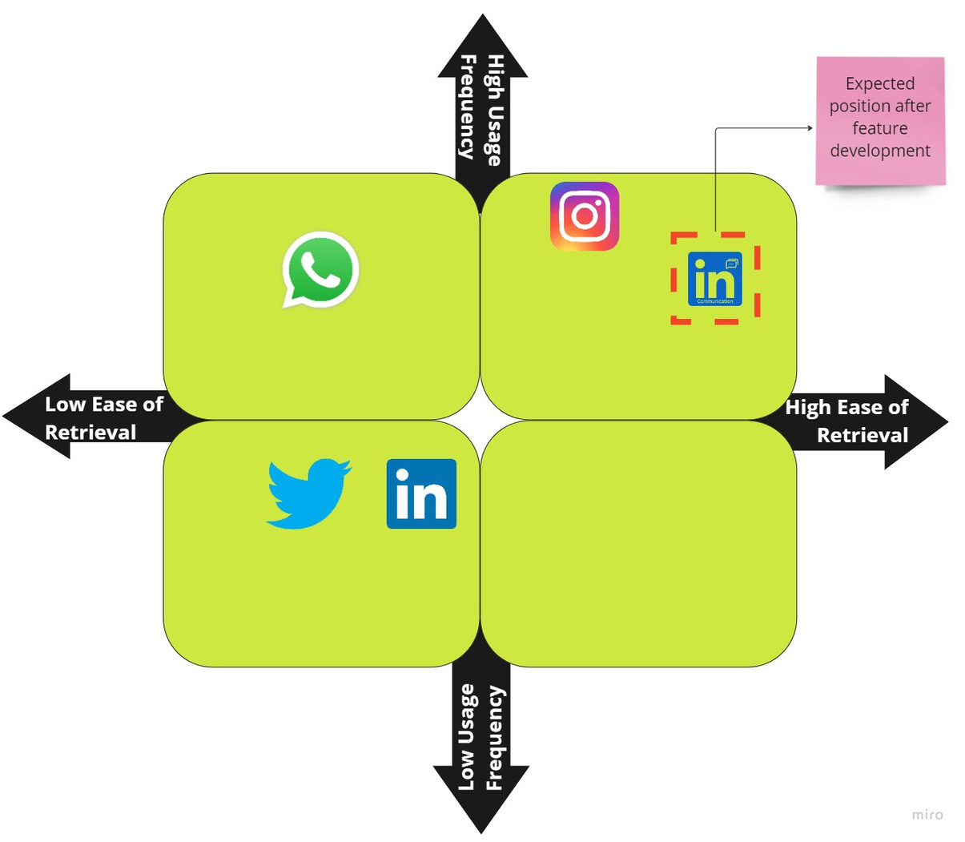

Competitor matrix for Saved post feature
Current State:
We need to scroll the entire list of saved posts to find the post.
Future State:
We can retrieve the post at the touch of a button.

Slide 11
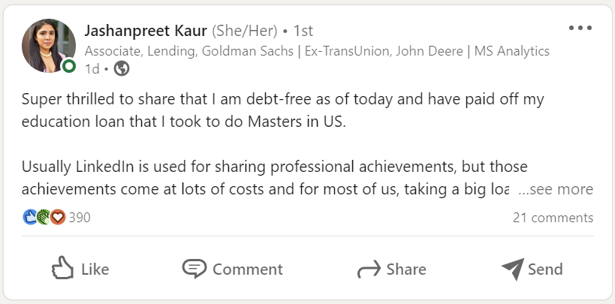
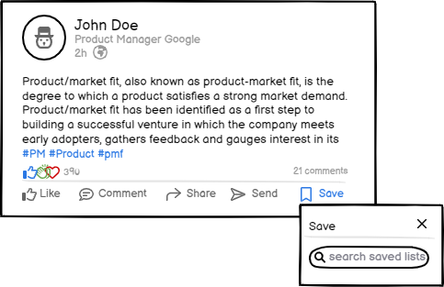
How will the new feature look
Current View
Suggested View
'49% Users do not know about saved post feature'

Slide 12
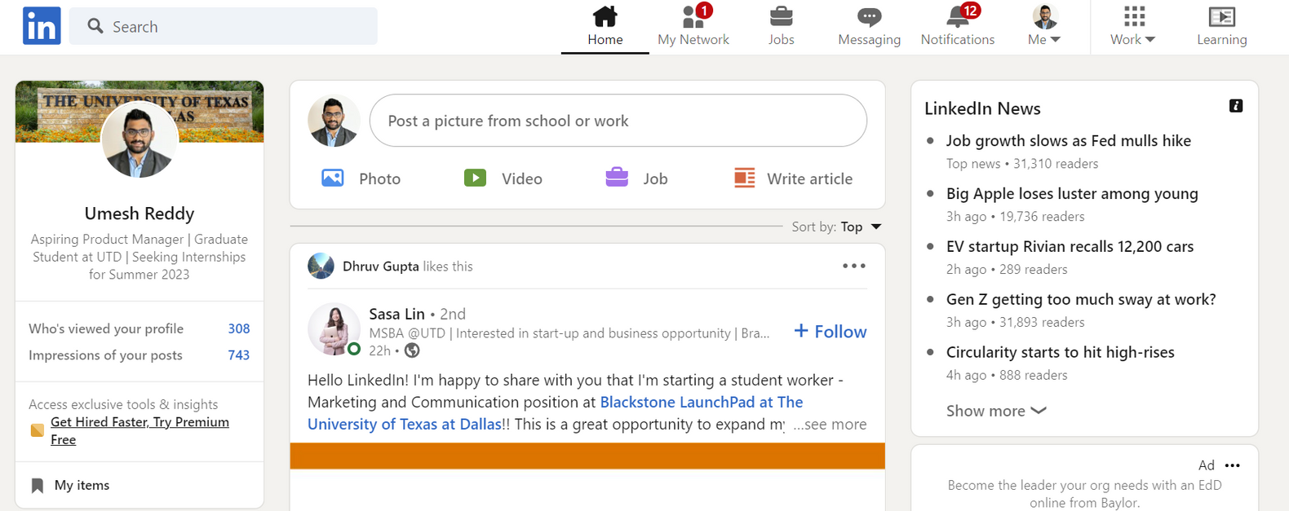
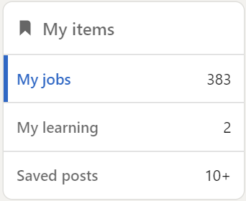

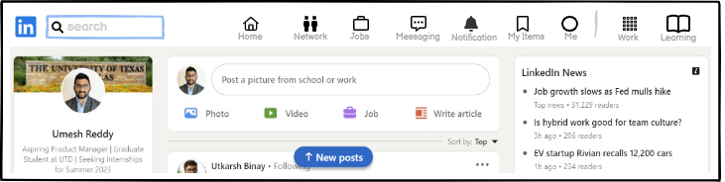
Current View
Suggested View

Slide 13
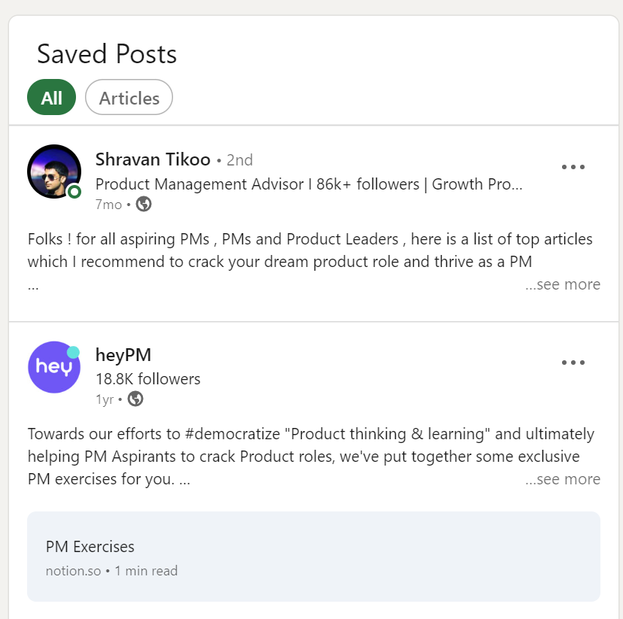
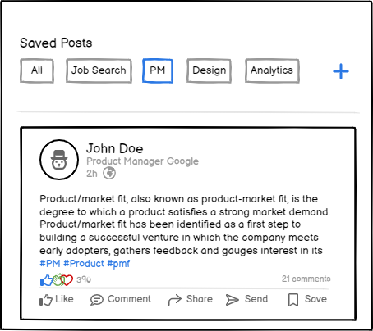
Current View
Suggested View
'71.2% Users are not able to retrive saved post with current view'

Slide 14
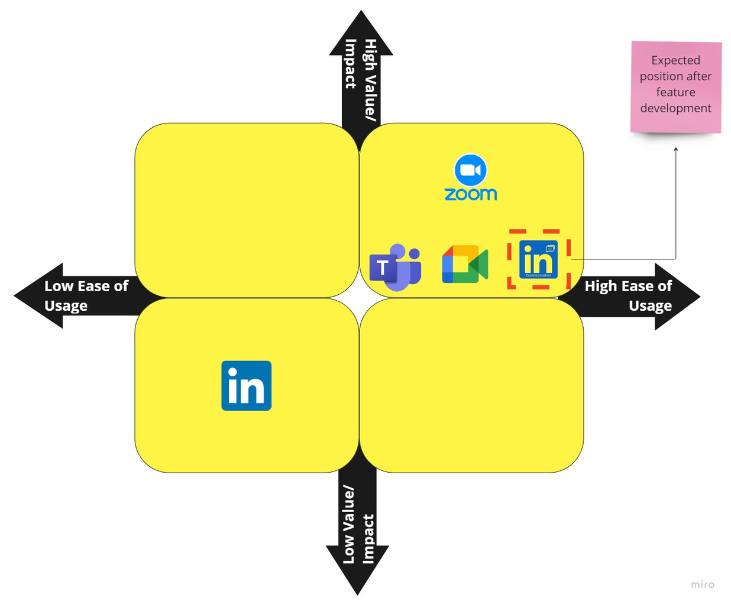
Competitor matrix for Video Calling Experience
Current State:
You need to use other video calling services to use the whiteboard feature.
Future State:
Adding whiteboards and blur background features enables LinkedIn meetings to be on top and can be used for hiring interviews.

Slide 15
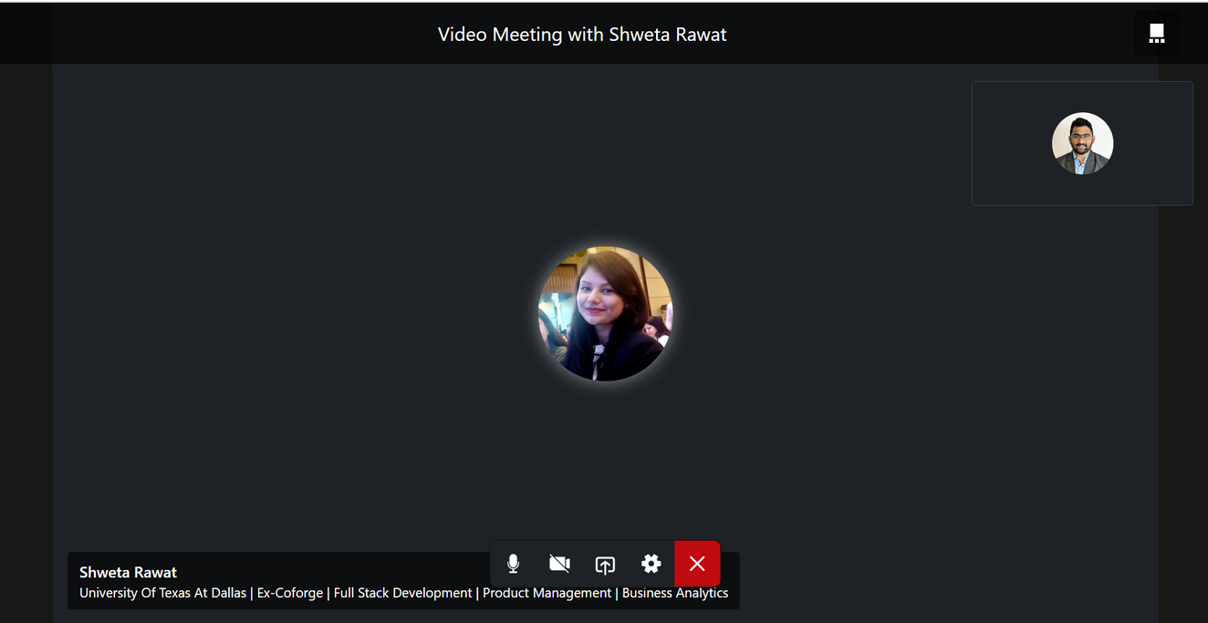
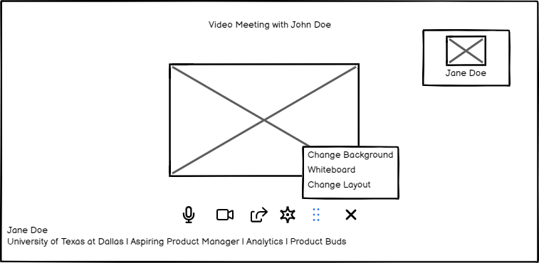
Current View
Suggested View

Slide 16






3 C's
Customer
Competition
Company
Students
Recruiters
Working professional
Teams
Zoom
Instagram
Twitter
Slack
Medium
Customer Engagement
Ease of communication

Slide 17



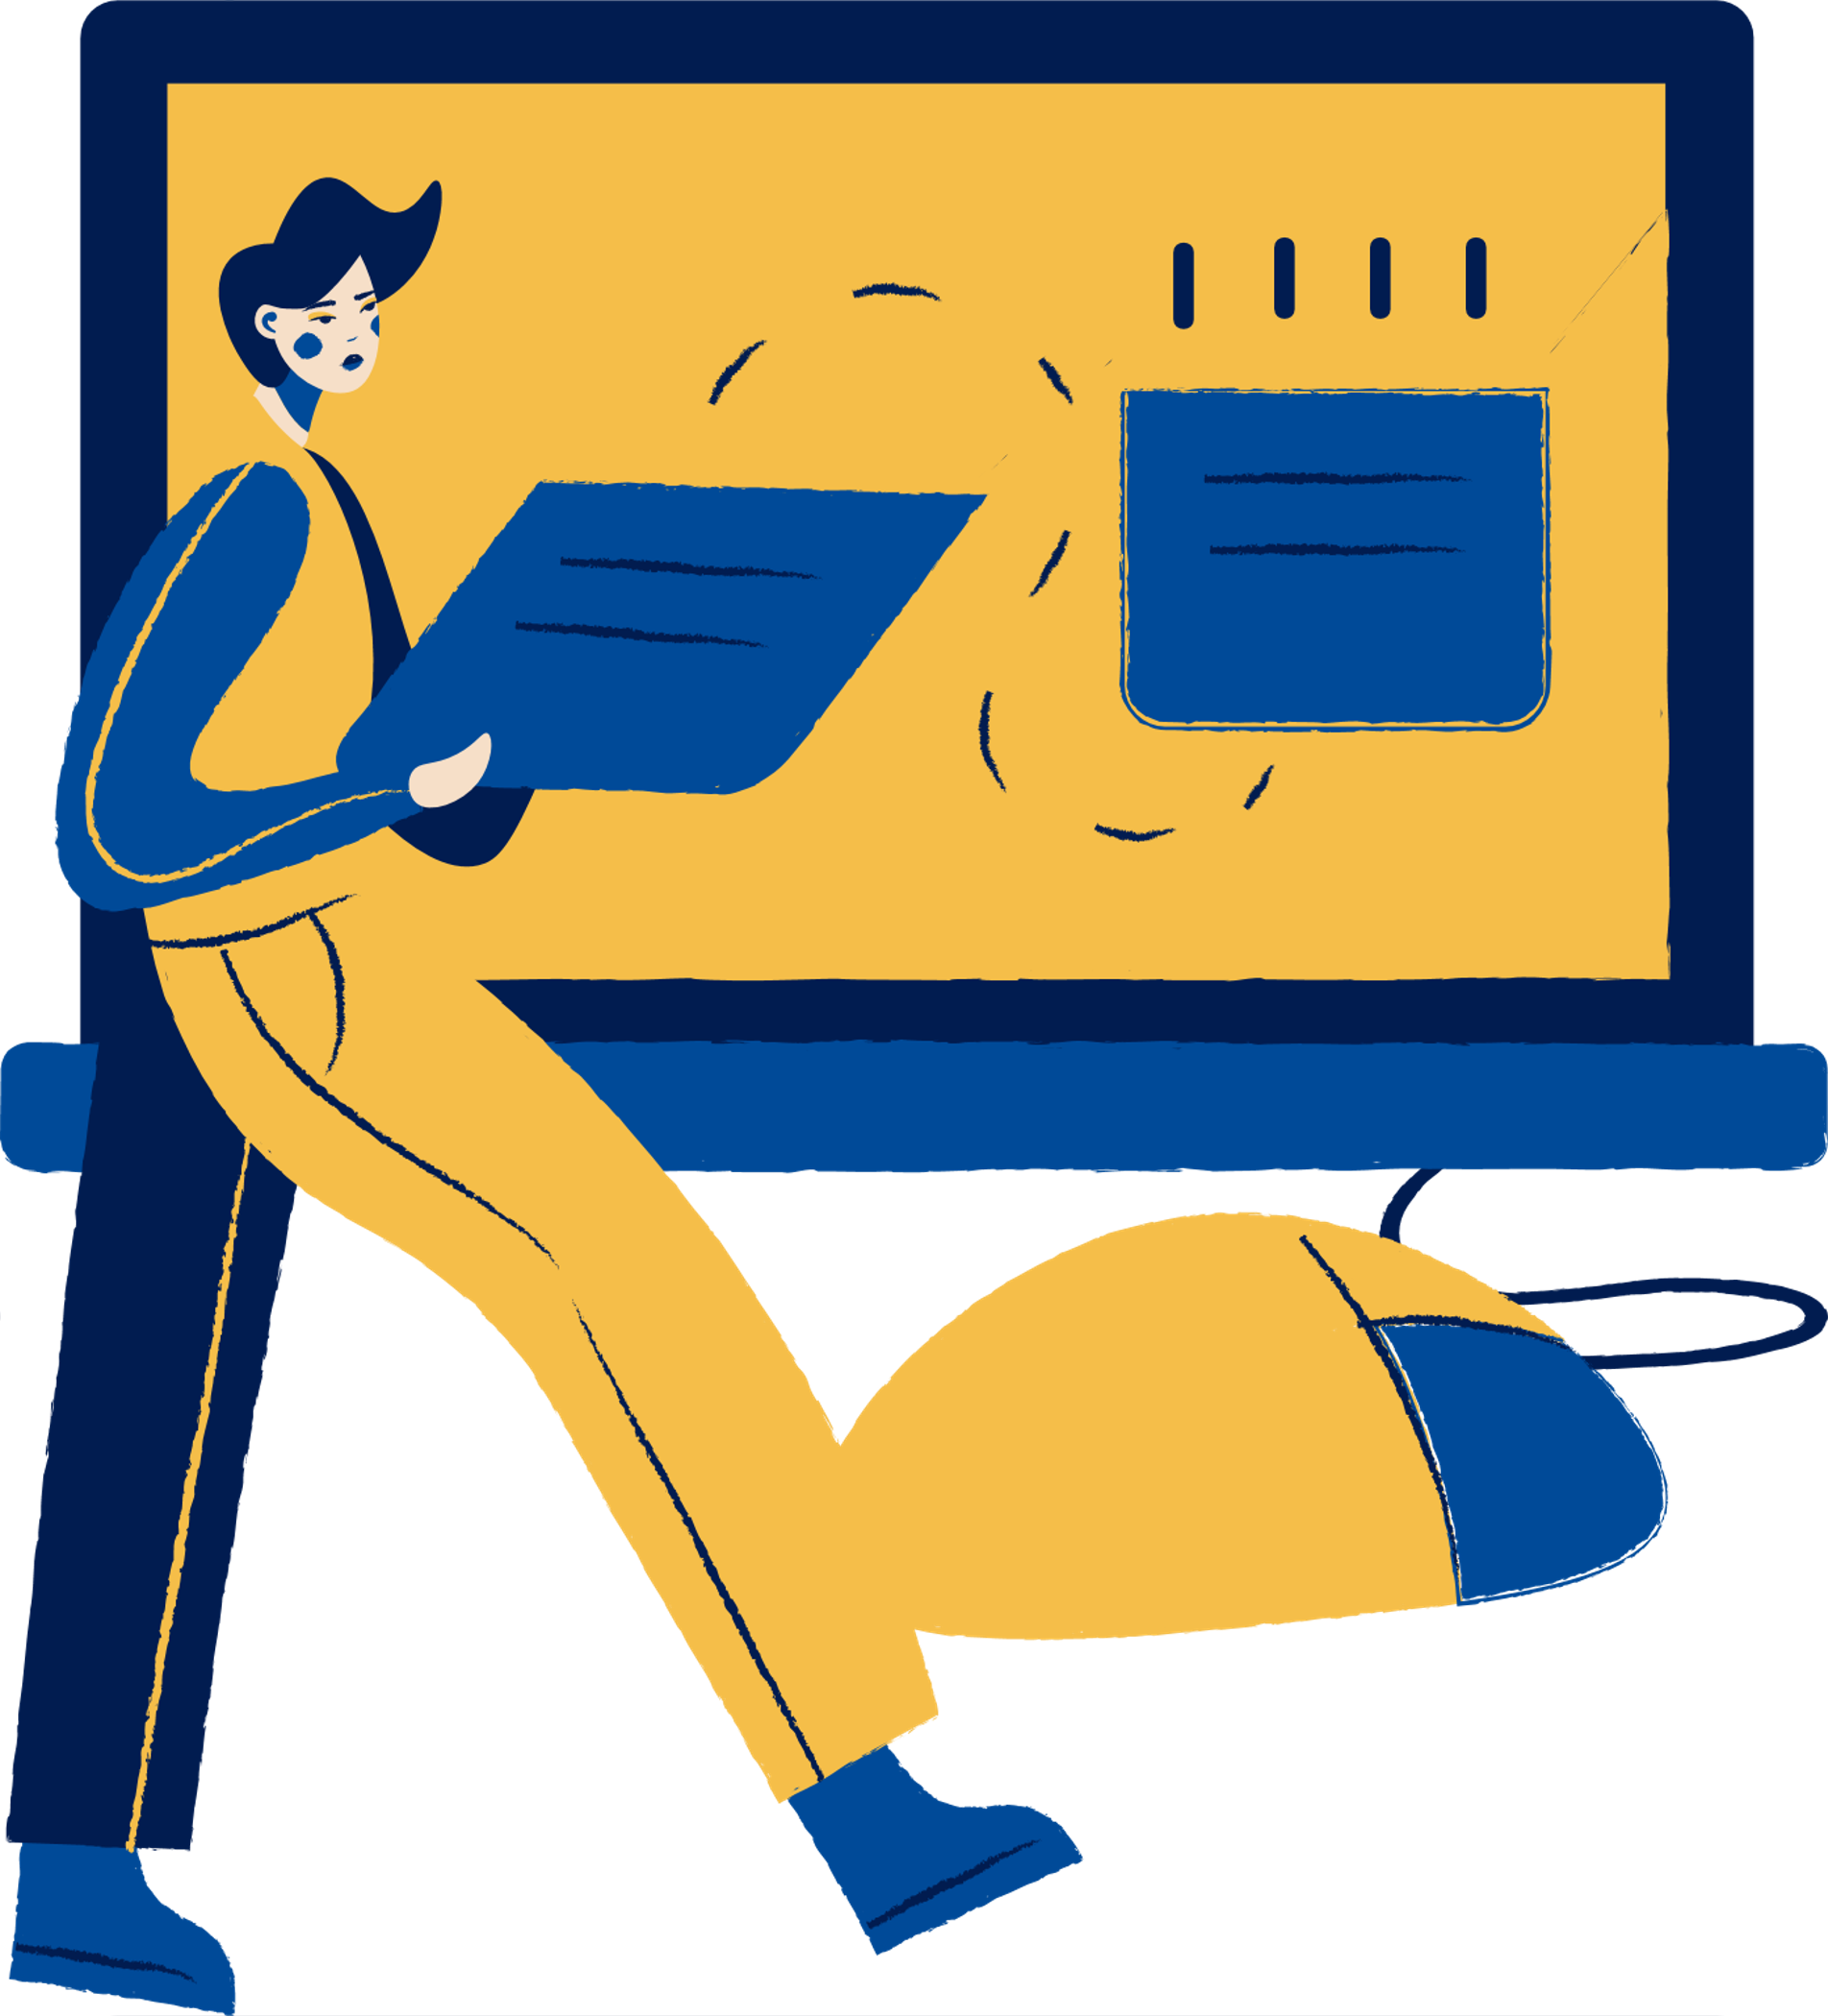
4 Ps
Resource
Page
Product
Pricing
Making information more accessible and organized
Wholesome interview experience
Free for all users
Promotion
Place
Email marketing
Google / Facebook ads
First, we will launch the mobile
Post website we will launch on the website
Use these icons and illustrations in your Canva Presentation. Happy designing!

Slide 18
Impact and Metrics to Track
Saved Post
Average Views per post
Customers using save post icon
Minutes spent on posts
Customers creating buckets and retrieving information
With Save Posts , the overall engagement of Linkedin will go up (Around 30 Million People use Linkedin on a daily basis)
Whiteboard/Blurr
Number of people using Video Calling
People using whiteboard features
People giving interviews
People getting hired
With Linkedin Video Calling , the overall experience of hiring and getting hired will improve, making LinkedIn an wholesome application for hiring process
(Around 7 Million People use Linkedin for job search)

Slide 19
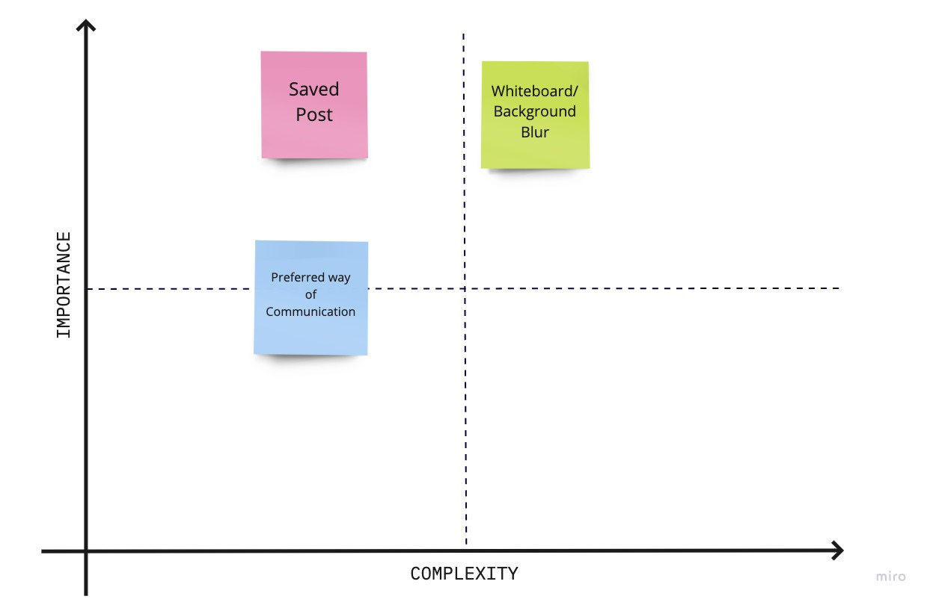
Feature Prioritisation Matrix

Slide 20

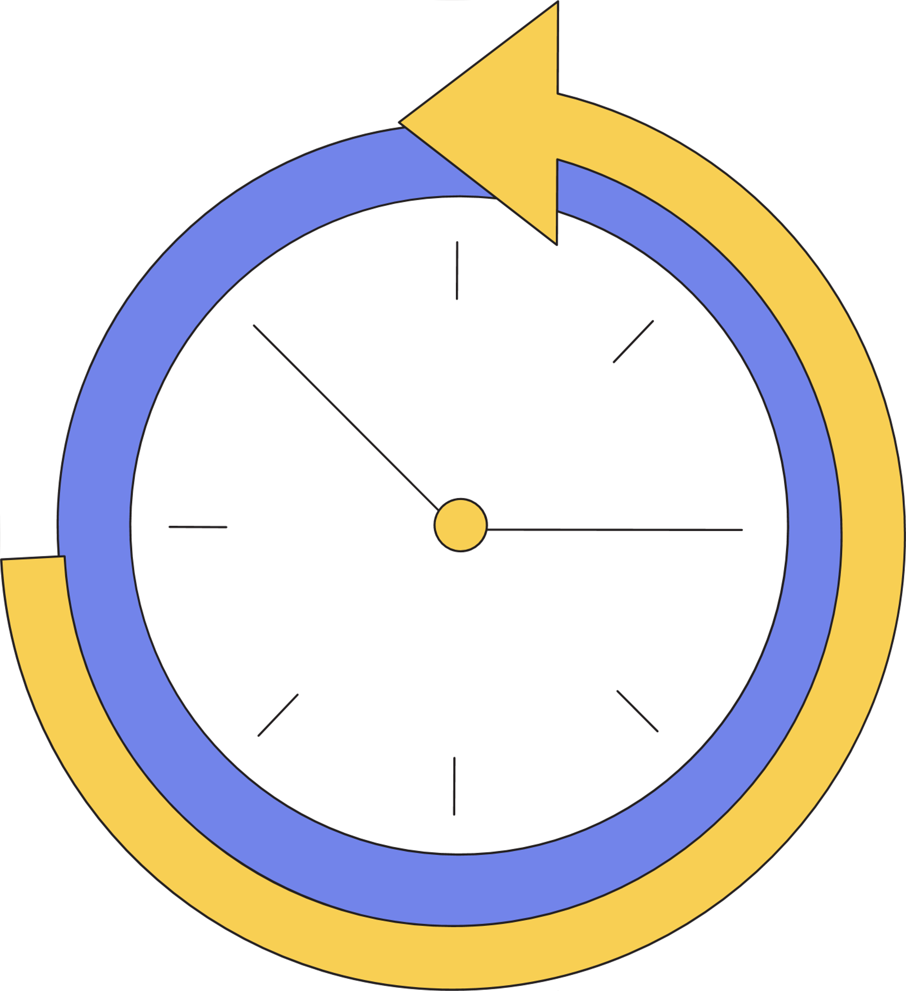
RoadMap
2002
2005
2007
2011
2012
2016
2020
Linkedin is
founded
“Groups” feature added
“Profile views” feature is released
“Apply with LinkedIn” feature introduced
"LinkedIn’s Learning" Solutions is
launched
LinkedIn introduces "endorsements"
“LinkedIn Events” launched
Raised 10 Mn
1 million users reached
Raised 50 Mn
500 employees
LinkedIn’s mobile version is introduced
LinkedIn acquires SlideShare
LinkedIn’s acquisition by Microsoft
2022
LinkedIn Communication Feature introduced
“Save post” feature categorised
"Whiteboard" and "Blur" feature Added
Preferred way of communication

Slide 21
Thank you!

